Slide 1

North Western University, Khulna
Project Name: T-Shirt Stock Management System
Course Code: CSE-3204
Course Title: Software Development Sessional III
August 23,2022

Slide 2

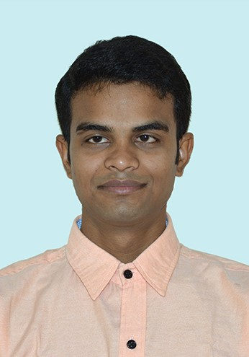
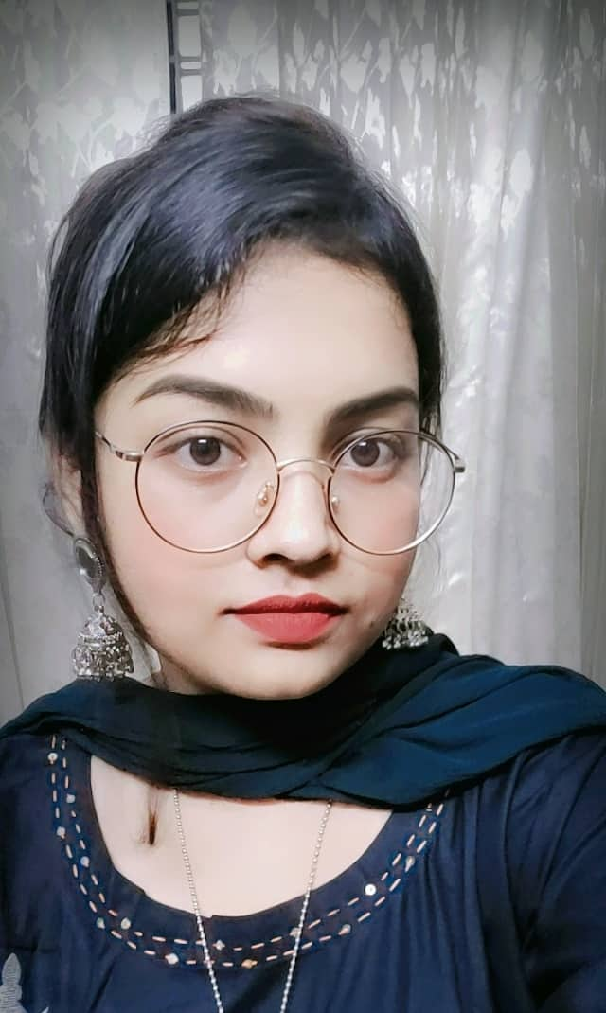

Team Name
NWU_TSMS
Details Of Team Members
Name: Nayan Sarkar
ID: 20201126010
Department Of CSE
North Western University
Khulna, Bangladesh
Moupia Mazumder Mou
ID: 20201146010
Department Of CSE
North Western University
Khulna, Bangladesh
Name: Asmaul Husna Mony
ID: 20201157010
Department Of CSE
North Western University Khulna, Bangladesh

Slide 3
Overview
Introduction
Description
Admin Panel
Objectives
User Mode
Entity Relationship Diagram
Dependencies
Site Tree
August 23,2022

Slide 4
Introduction
T-Shirt management system is software developed with PyCharm tkinter framework to handle the basic functions of a t-shirt store.
It keeps a track of add product, show product, search product, update and delete product, order product to the website.
It helps to provide information on any product present in the shop to the user
August 23,2022

Slide 5
Objectives
To make it easy for the customers.
The convenience of shopping at home.
Simplify order system.
Build Digital shop infrastructure.
Managing multiple shop simultaneously.
Wide variety/range of products are available.
Get detailed information about the product.
Managing multiple users in different shops.
August 23,2022

Slide 6
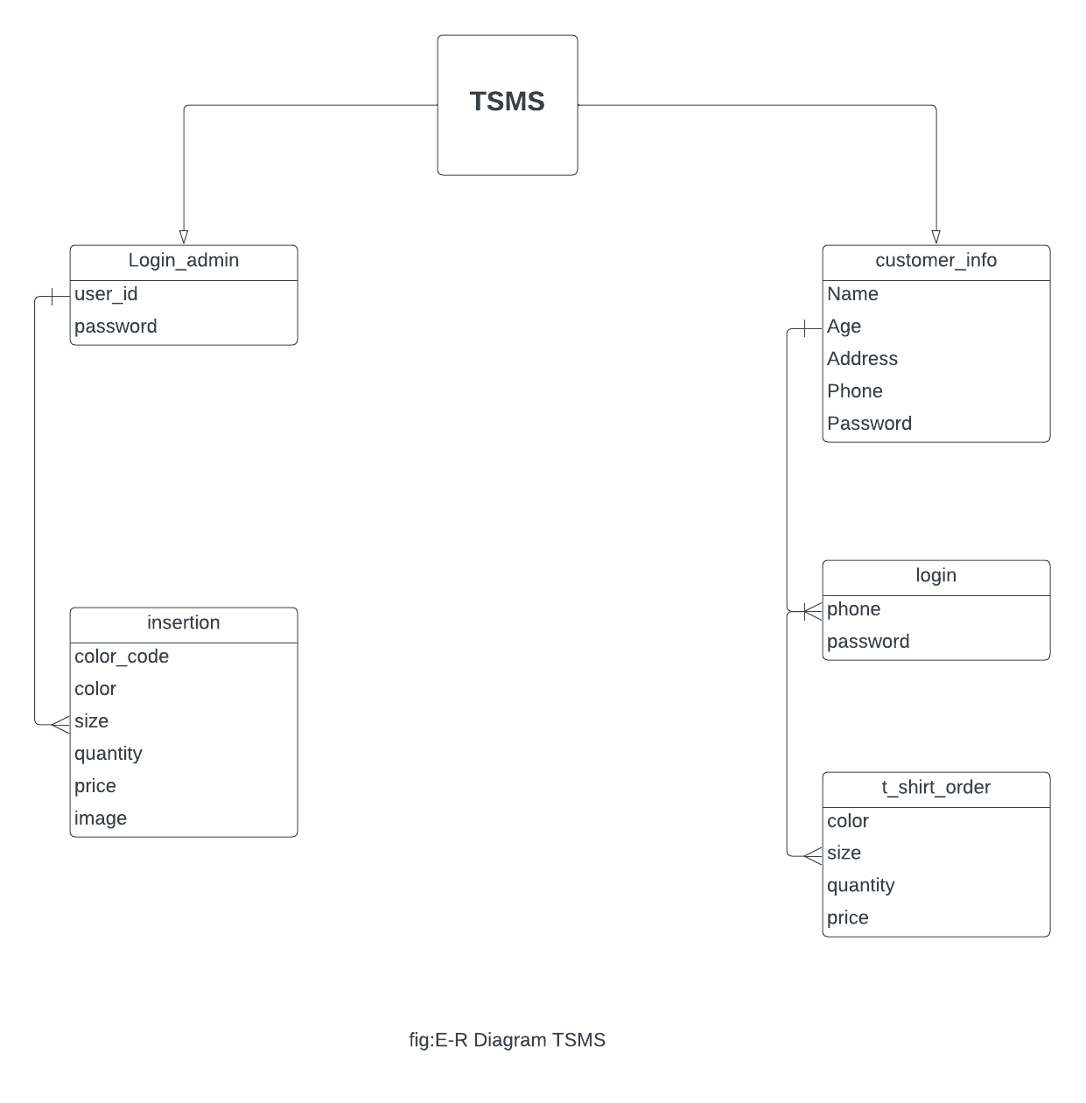
Entity Relationship Diagram:
August 23,2022

Slide 7
Site Tree:
T-Shirt Stock Management System
Admin
User
SIGN UP
LOGIN
INSERT
LOGIN
SEARCH
SHOW
VIEW PRODUCTS
SELECT
UPDATE
ORDER
August 23,2022
DELETE

Slide 8
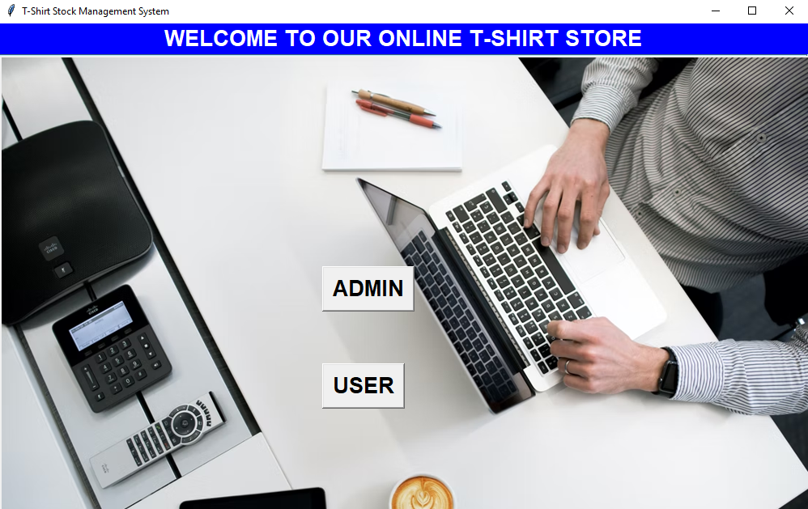
Admin Panel
This is the home page of our online T-shirt store.
August 23,2022

Slide 9
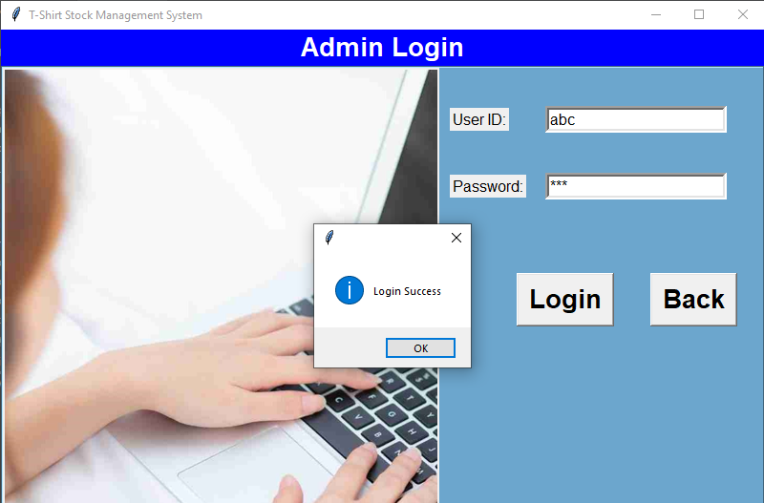
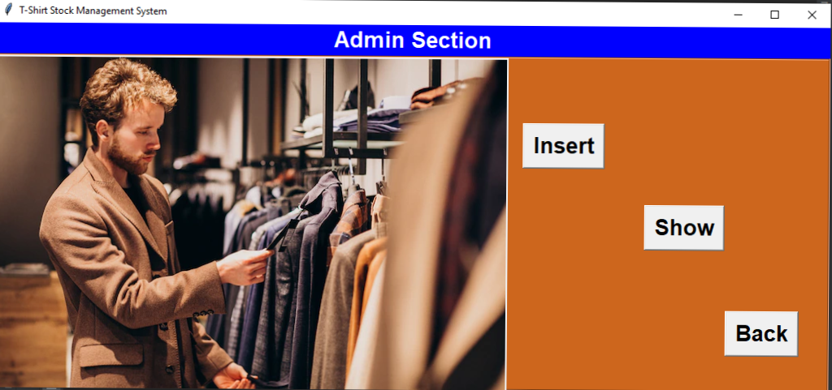
Admin
Admin Login
In this page the admin can login into admin section page.
After login, the admin will view this admin section page.
August 23,2022

Slide 10
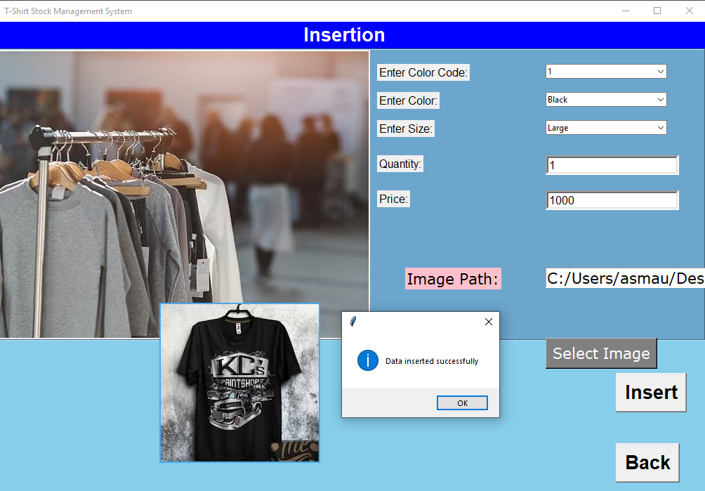
Insert
Clicking the “Insert” button, the admin can insert the new products.
August 23,2022

Slide 11
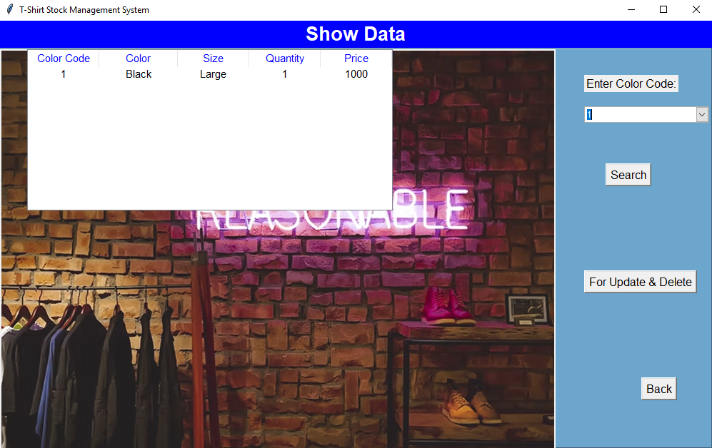
Show
Clicking the “Show” button, the admin can show or search the products by selecting the color code.
August 23,2022

Slide 12
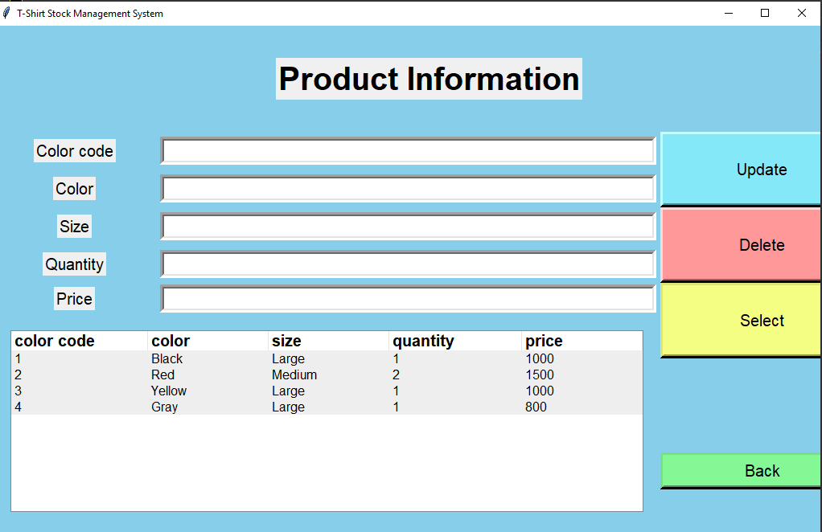
For Update and Delete
In this page the admin can show all the products information by tree view.
There are three options in the page like “Update” ,”Delete” ,”Select”.
August 23,2022

Slide 13

Home Page
August 23,2022

Slide 14
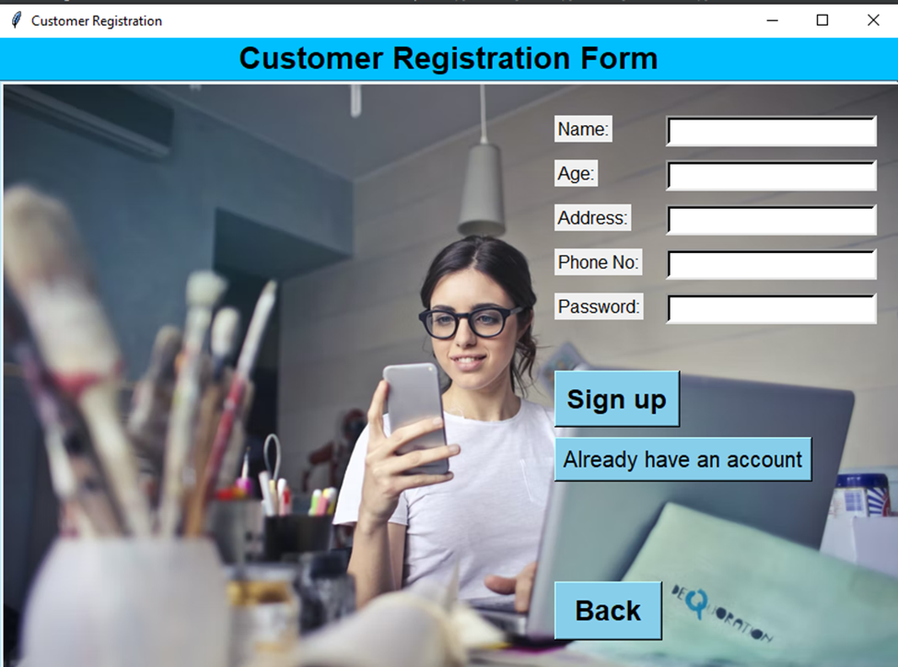
Sign Up
After Clicking “User” button, the user will view this Customer Registration form page:
August 23,2022

Slide 15
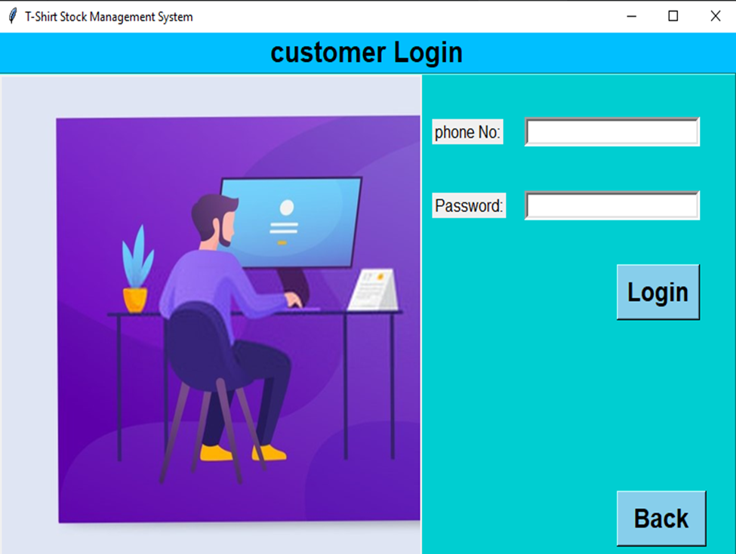
After clicking the “Already have an account” button, the user can see the Login page.
Login Page
August 23,2022

Slide 16
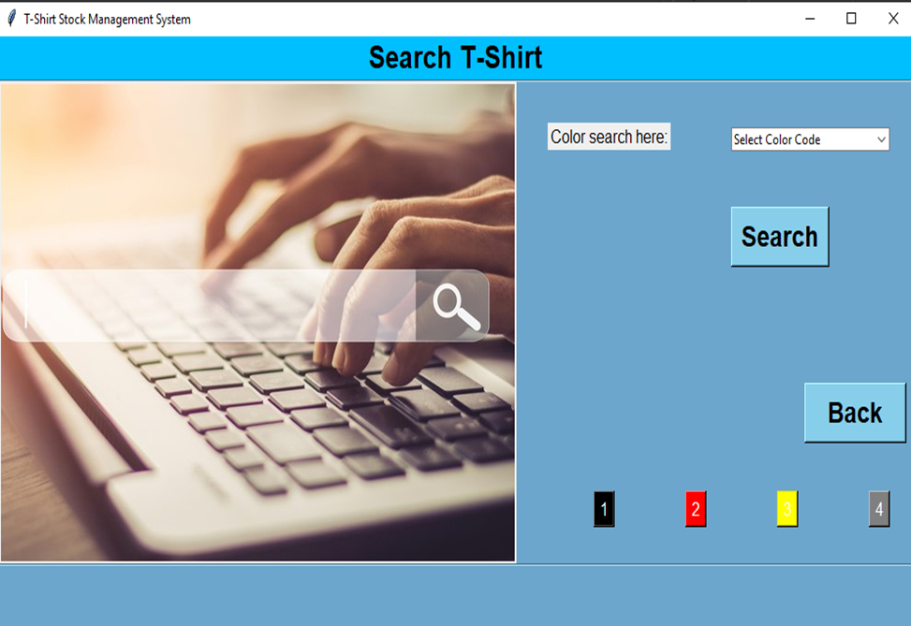
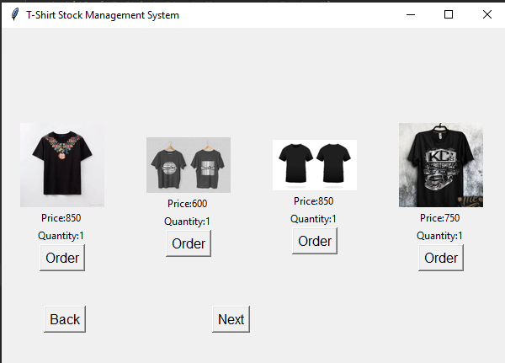
Login
Search for desired t-shirt
view some t-shirts by the system
August 23,2022

Slide 17
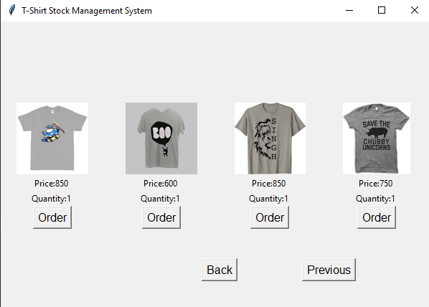
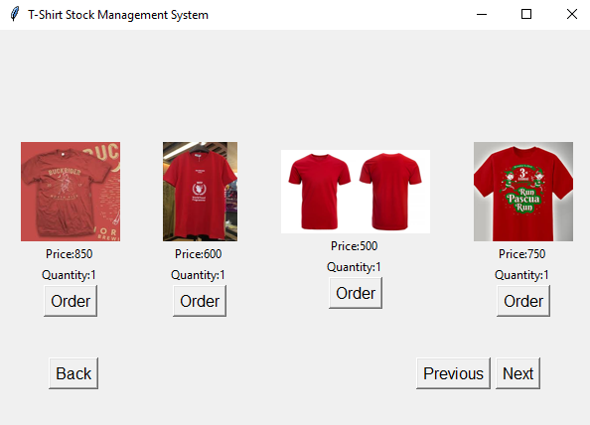
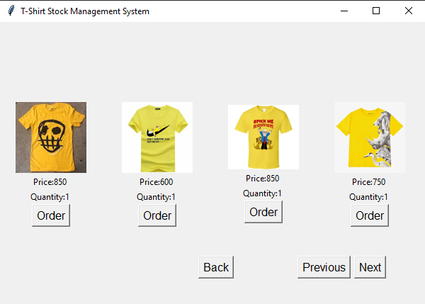
August 23,2022

Slide 18
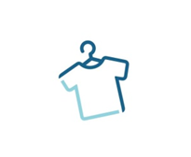
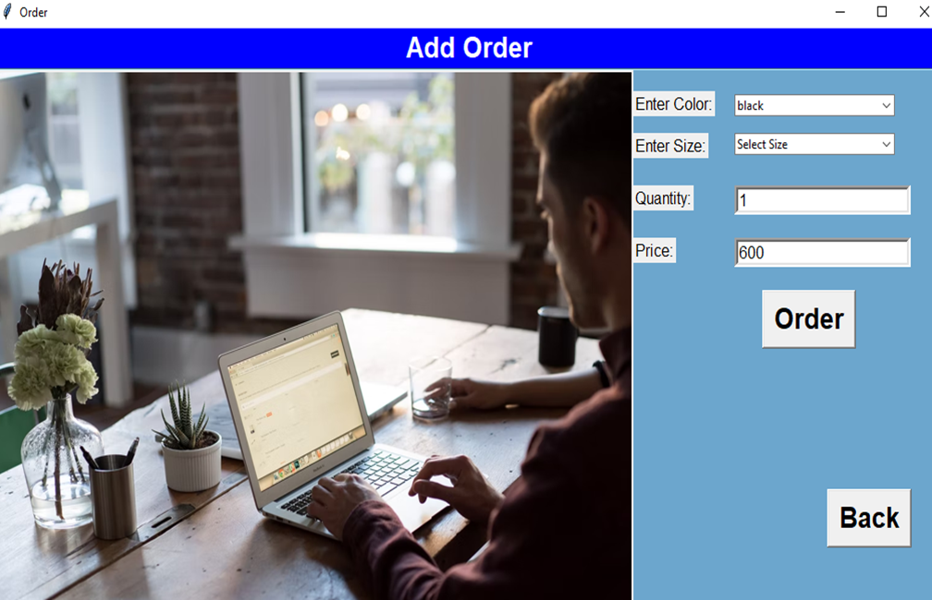
Order
User can modify their choice
Selects t-shirts by clicking the “Order” button
August 23,2022

Slide 19
Conclusion
Designed and developed to be online
Friendly and easy to use
Provide services for individuals and secure
Users should be able to find what they are looking

Slide 20
Dependencies:
1. PyCharm: The T-Shirt Stock Management System (TSMS) is built on PyCharm tkinter framework. So PyCharm tkinter framework is needed to run this system properly.
2. XAMPP: In this system use MySQL database. So XAMPP is must be needed to run the system properly.
August 23,2022

Slide 21

August 23,2022

